Slide 1
Integrating Science Gateways with Secure Cloud Computing Resources: An Examination of Two Deployment Patterns and Their Requirements
Marlon Pierce, Suresh Marru
Cyberinfrastructure Integration Research Center
circ@iu.edu, marpierc@iu.edu

Slide 2
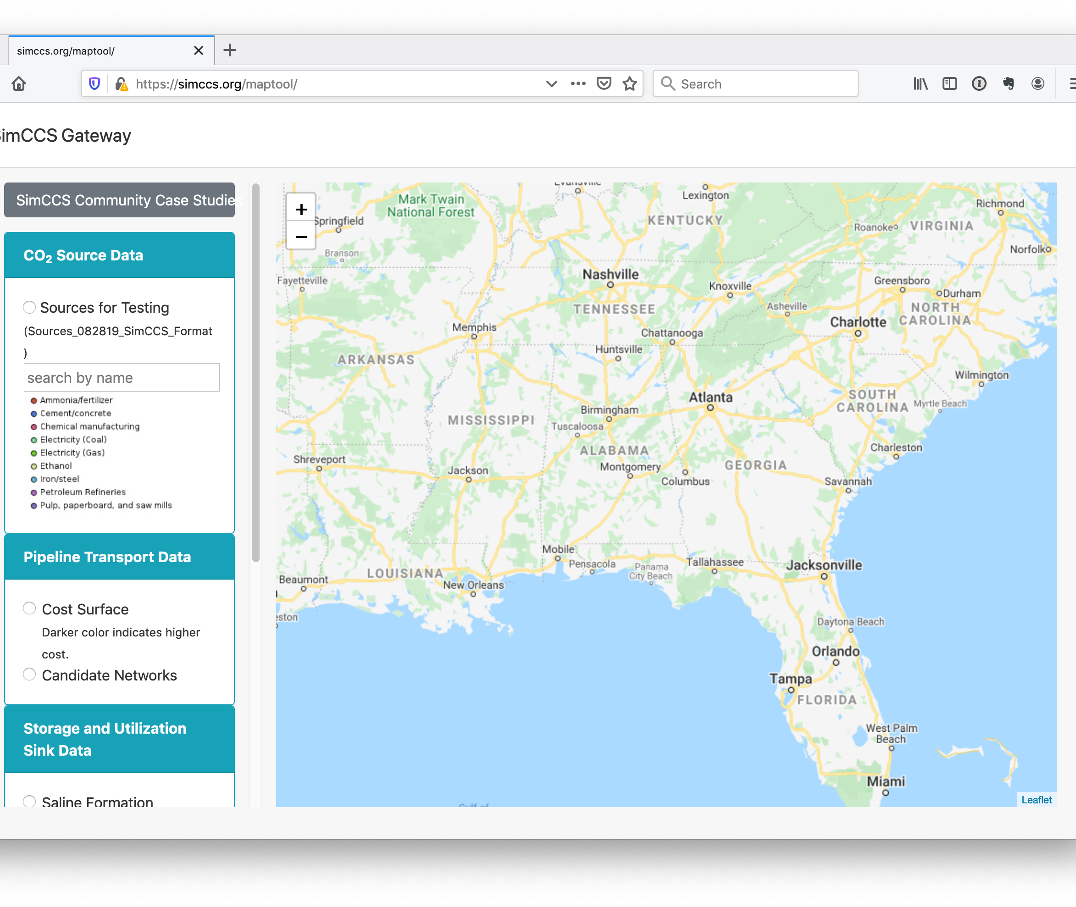
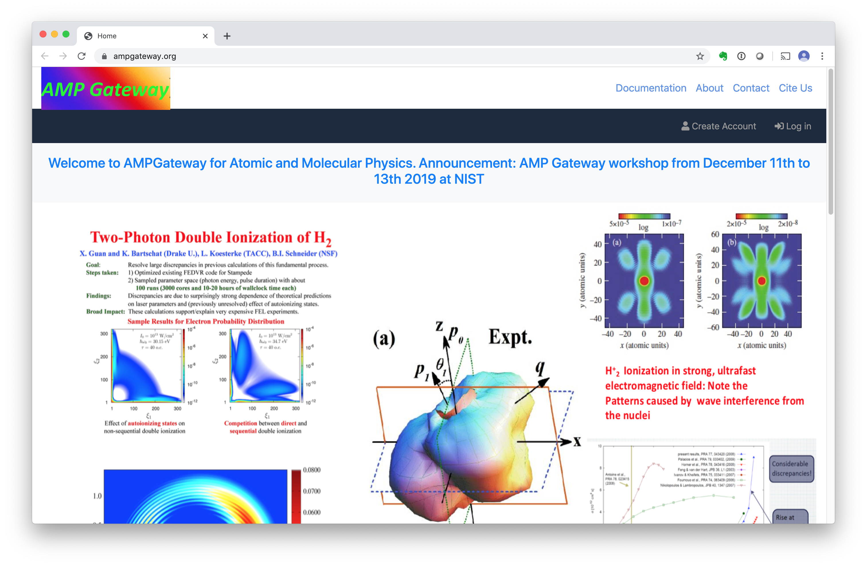
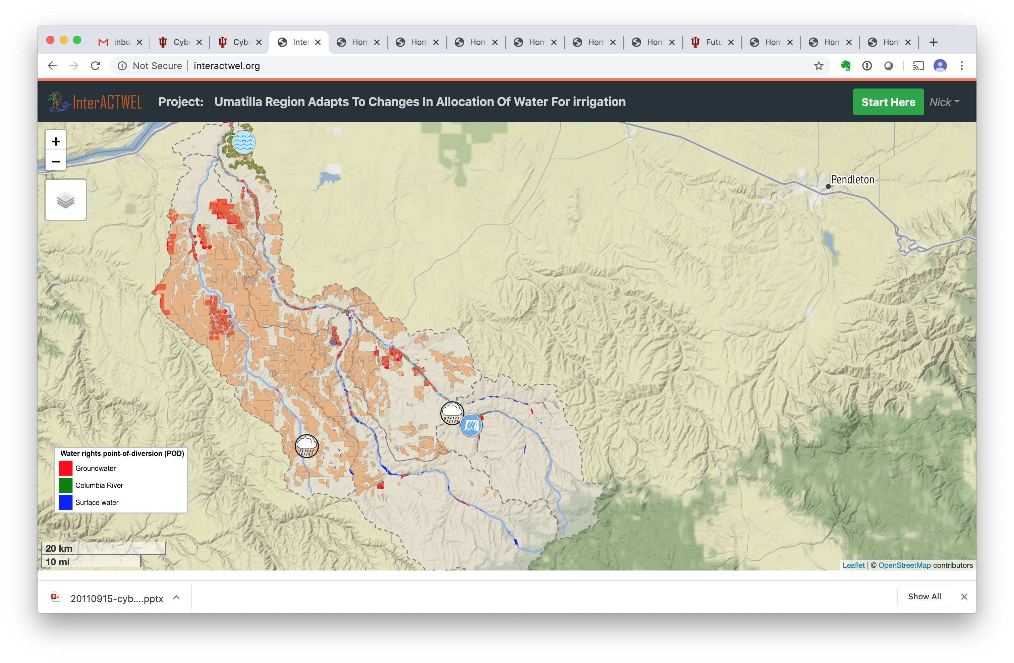
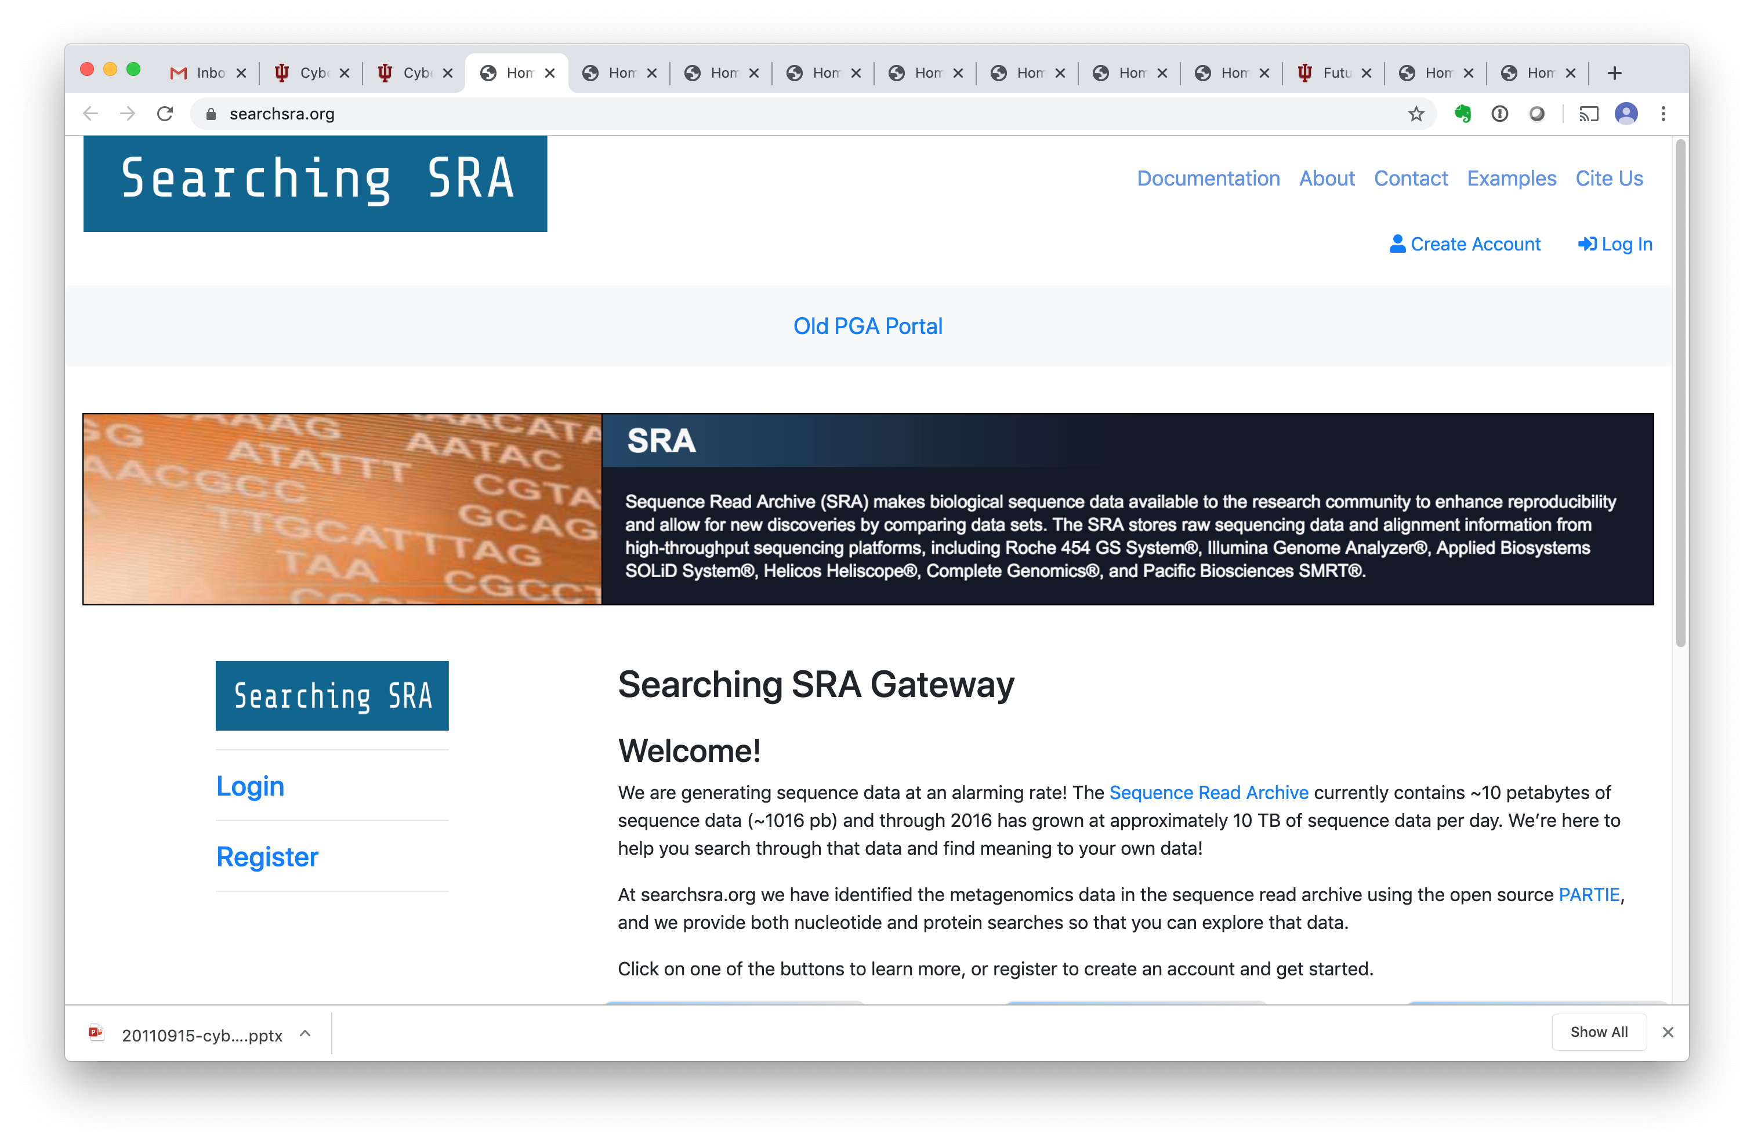
Science Gateways
Provide Web interfaces that support the use of remote, distributed scientific applications, data, and resources by research and education communities.
Encapsulate scientific user experience

Slide 3
Science Gateways Support FAIR Science
Manage users’ identities
Record computational experiments as digital objects
Allow you to save and reuse your digital objects
Share digital objects with your collaborators
Pierce, M.E., Miller, M.A., Brookes, E.H., Wong, M., Afgan, E., Liu, Y., Gesing, S., Dahan, M., Marru, S. and Walker, T., 2018. Towards a science gateway reference architecture.
http://hdl.handle.net/2022/22235

Slide 4

The Open Science Scenario for Science Gateways
How things typically look

Slide 5
BYOR: Bring Your Own Resources
Gateways can aggregate multiple resources into a single system
Commercial clouds, national cyberinfrastructure, university resources, lab resources

Slide 6
State of Science Gateways
Numerous high-quality science gateway software systems already exist
Don’t write your own
Science gateway platforms and hosting solutions are available
You don’t even have to run it yourself
The Science Gateways Community Institute is an NSF-funded effort to serve, lead, and coordinate this community.

Slide 7
Gateway Roles
Users
The end user community that the gateway serves
Providers
The individual or group that provides the gateway to a community
Software Providers
Develop and distribute science gateway software
Platform Providers
Operate science gateway software for gateway providers

Slide 8
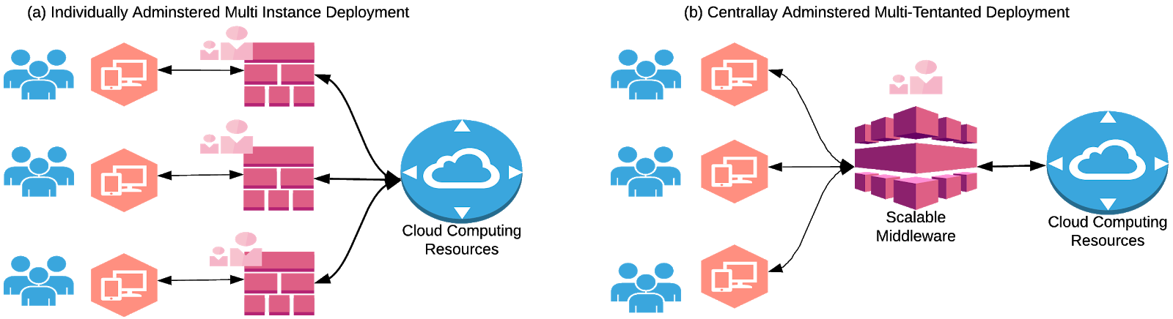
Multi-Instance Platforms

Slide 9
Multi-Tenant Gateway Platforms

Slide 10
At CIRC, We Vote Multi-Tenant
Drive down operation overhead costs.
This requires a highly configurable, customizable front end.
Must have a good turnkey/out of the box user environment...
That is also highly customizable and extensible
Clients cover the cost of developing their gateways
Or they collaborate with us to build it with/for them.
Powered By

Slide 11
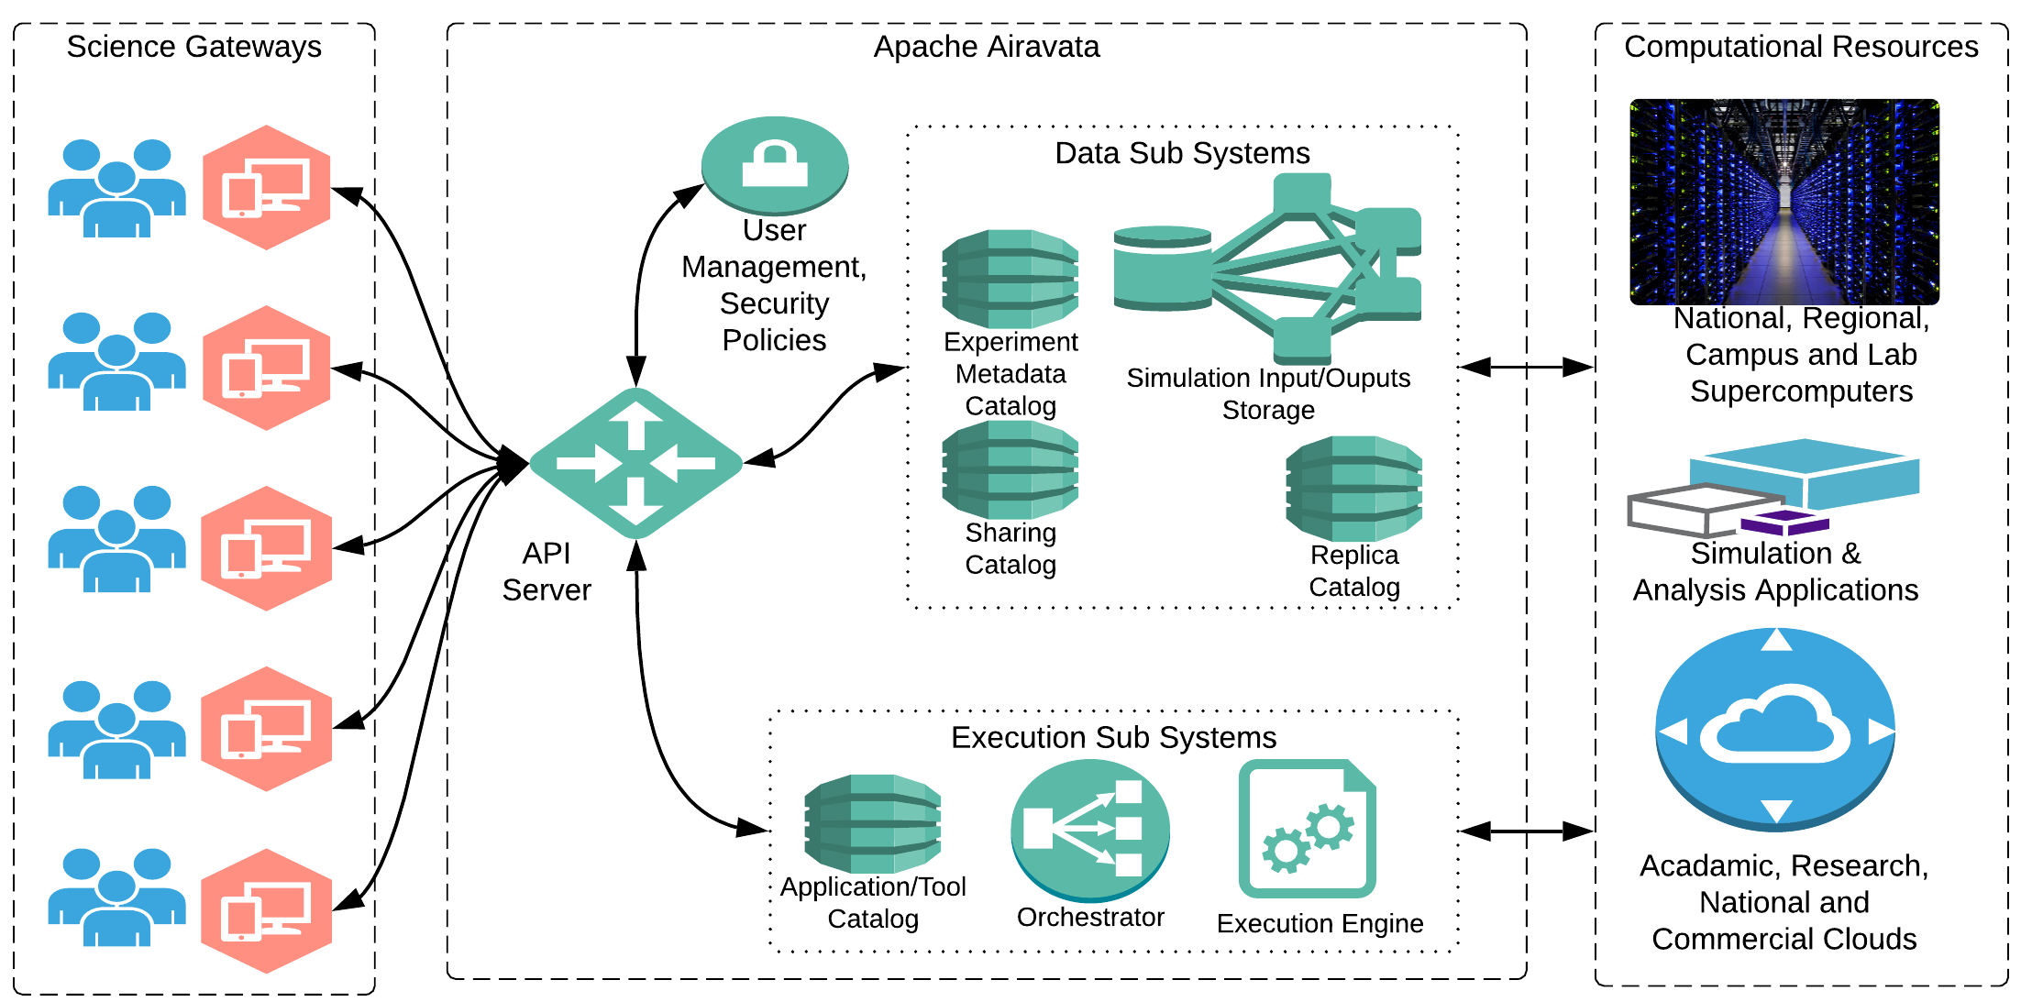

Slide 12

Does This Approach Work for Protected and Regulated Data?

Slide 13
Some Protected Data Examples
Critical infrastructure data
Law enforcement data
Health information
Export controlled modeling and simulation software
Proprietary private sector intellectual property (models, computational workflows, data sets)
https://www.archives.gov/cui/registry/category-list

Slide 14
Controlled Unclassified Information (CUI)
A uniform approach in the US for how third parties (like universities) can handle protected data.
NIST 800-171 defines the compliance details
NIST 800-171 may be useful on general grounds for sensitive but non-CUI data

Slide 15
Commercial Clouds Are Well-Positioned to Help Satisfy NIST 800-171 Requirements
Physical security, network security, logging and auditing, etc
Universities should strongly consider using cloud vendor-supplied CUI infrastructure as a service

Slide 16
Gateways Provide Several of Advantages for Accessing CUI
Authentication, Access Control through a User Interface
Gateway user interfaces control what actions gateway providers allow on the CUI
Gateway middleware can make auditing manageable and centralized
Gateway users don’t have direct access to CUI-hosting infrastructure

Slide 17
Multi-Tenanted Gateway Platforms for CUI?
Can you have different, unrelated gateways targeting different CUI deployed on different cloud vendors?
A key architectural difficulty is establishing a secure network around two separate systems

Slide 18
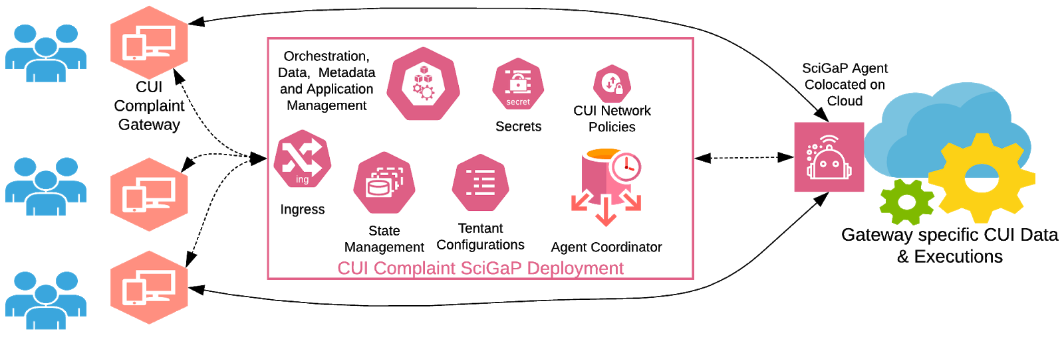
A Possible Solution for Multi-Tenanted Platforms
Extend the gateway platform to have agents running in a DMZ on the cloud.
Keep the CUI on a controlled “internal” network
Agents are gatekeepers for all instructions coming from the middleware
The agent provides strict control of allowed operations on
You can build on standards like OAuth2

Slide 19
Multi-Instance Platforms for CUI
Why not just have one gateway instance for one instance of CUI?
Co-locate the gateway with the CUI on NIST 800-171 compliant cloud infrastructure

Slide 20
Think Like a Business
You can do this once
But can you do it N times?
And make each time less expensive then the time before? And the cost savings are accelerating?
Engineer your platform’s continuous integration and deployment systems to make this scalabe with a small operations team

Slide 21
Disadvantages for Multi-Instances
Supporting multiple gateway instances is more expensive than supporting tenants
Doesn’t scale like multi-tenanted systems
Can you drive down costs for each CUI deployment, or does each one require significant effort?

Slide 22
Key Questions for Platform Providers
What is the lifecycle of a CUI gateway?
Will serve a user community indefinitely?
Or is it short-lived?
Is the gateway needed to support collaboration and reproducibility?
Or are the users uncorrelated?

Slide 23
Cost-Benefit Analysis
How much will it cost to make a CUI platform?
CUI gateways are expensive even if you have a platform. What is the market?
How much should a gateway platform provider charge each CUI gateway?
Is it worth having two versions of your platform?

